Slide 1

Innovation Center Chatbot Project
Text Analytics — Final Presentation
December 2021
Chensheng Wen
Hazel Chrobet
Xuan Liu
Notes:
xuan

Slide 2

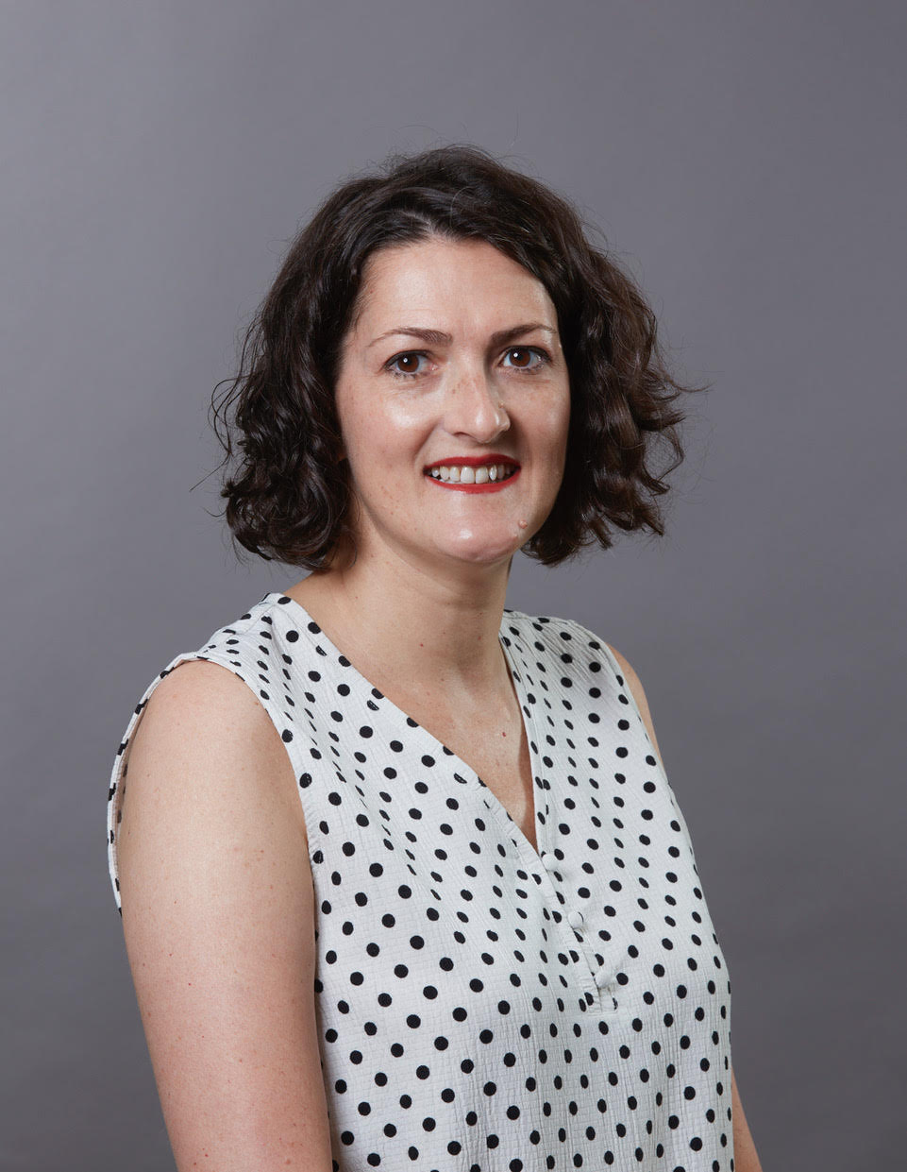
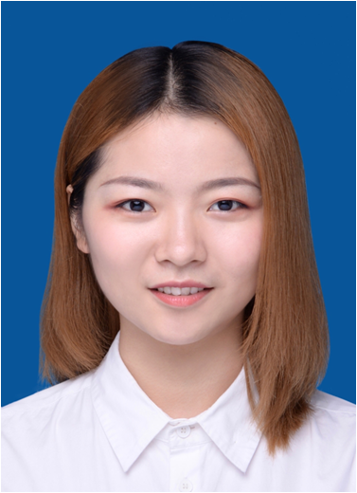
Our Team
Chensheng Wen
MSBA student
China
Hazel Chrobet
MSBA student
Ireland
Xuan Liu
MSBA student
China
Notes:
xuan, chensheng and hazel introduce

Slide 3
Agenda
Introduction
Overview
Libraries We used
Beta: Pros and Cons
Methodology
Beta Chatbot
Beta II: Proposed Improvements
Notes:
Xuan

Slide 4
Introduction: Project Goals
Based on Client Feedback
Increase awareness of the Innovation Center
Reduce the time spent responding to frequently asked questions
24/7 ability to answer general questions
Notes:
Xuan
24/7 means 24 hours a day and 7 days a week. Outside working hours as well as during working hours.

Slide 5

Chatbot Name & Logo
“iVA”
Notes:
Xuan

Slide 6
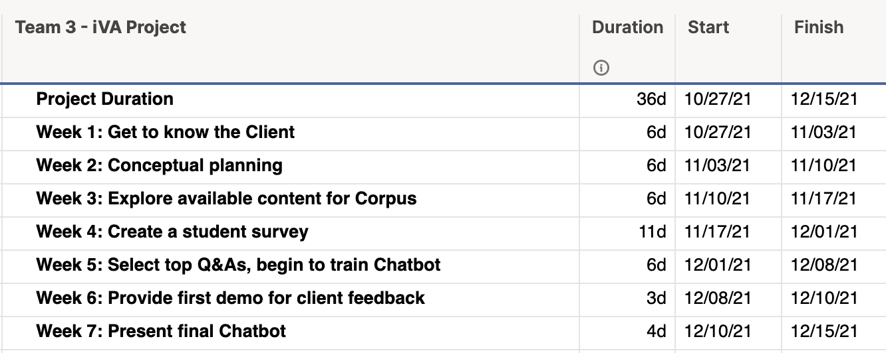

iVA Project Timeline
Notes:
Xuan - Gantt Chart

Slide 7

Overview: Design Thinking
Our Persona
International Students
Pain Points
Needs Statement
Notes:
Xuan
--Needs statement as an international student is to find a job or job experience.
--The IC cannot directly find jobs for students, but it can give students real work experience and offers skills and certificates (like the IBM Skills Academy) to make students more highly qualified for top positions.

Slide 8
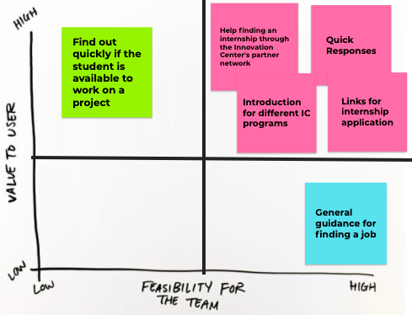
Design Thinking
Notes:
Hazel - this is called a Prioritization Grid or Matrix which shows the relative importance of a set of items based on two weighted criteria. In the case of this Chatbot project, we looked at the value to the user - international students and weighed it against the value and feasibility for our team. We looked at everything then narrowed it down to what we felt was realistic. What we could achieve in 7 weeks for this class.

Slide 9
Survey Research
Conducted Student Survey via Survey Monkey
Collected responses from 22 students who self-identified as:
6 international graduate students | 1 MS Supply Chain Mgmt student
4 MBA students | 1 recent graduate
4 MSBA students | 4 unknown
2 international undergraduates
Notes:
Hazel
Survey Monkey Dashboard: https://www.surveymonkey.com/stories/SM-KPW73RMQ/edit/

Slide 10
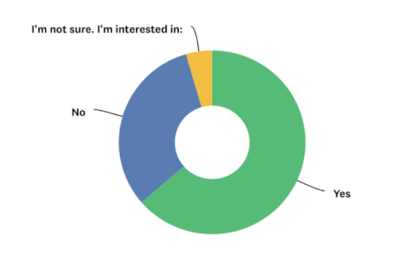
Survey Research
Q. Can I get a job through the Innovation Center?
A: Nearly 64% of respondents said YES
Notes:
Hazel
31.82% said NO
4.55% were Not Sure

Slide 11
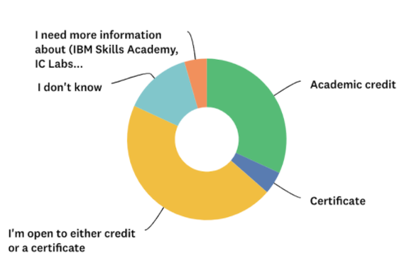
Survey Research
Q. Do you prefer academic credit or non-credit/certificate?
A: Over 45% of respondents were open to either.
Nearly 32% of respondents prefer to get academic credit.
Notes:
Hazel
Ask the client for their interpretation of whether or not that is the actual case (reality)

Slide 12
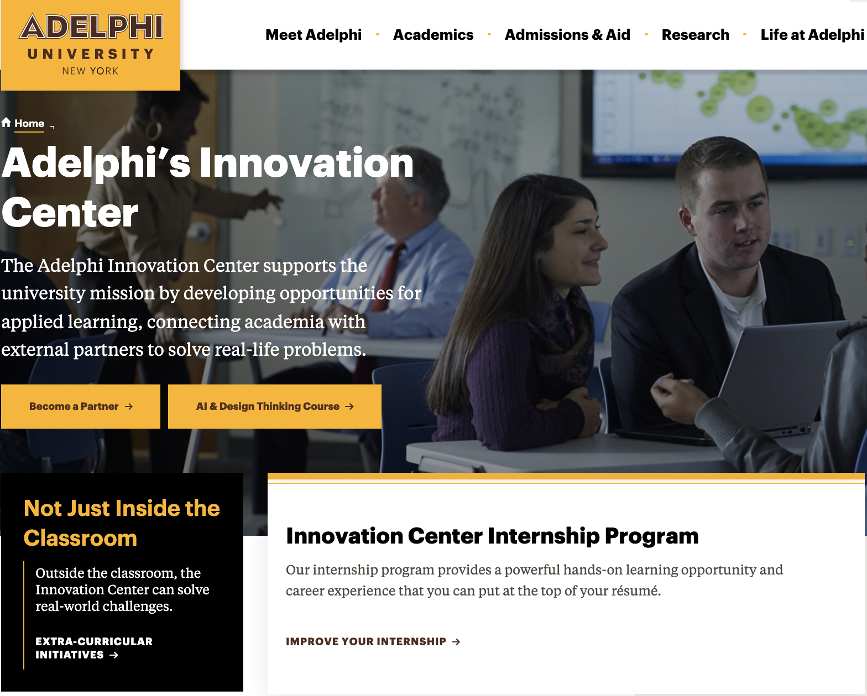
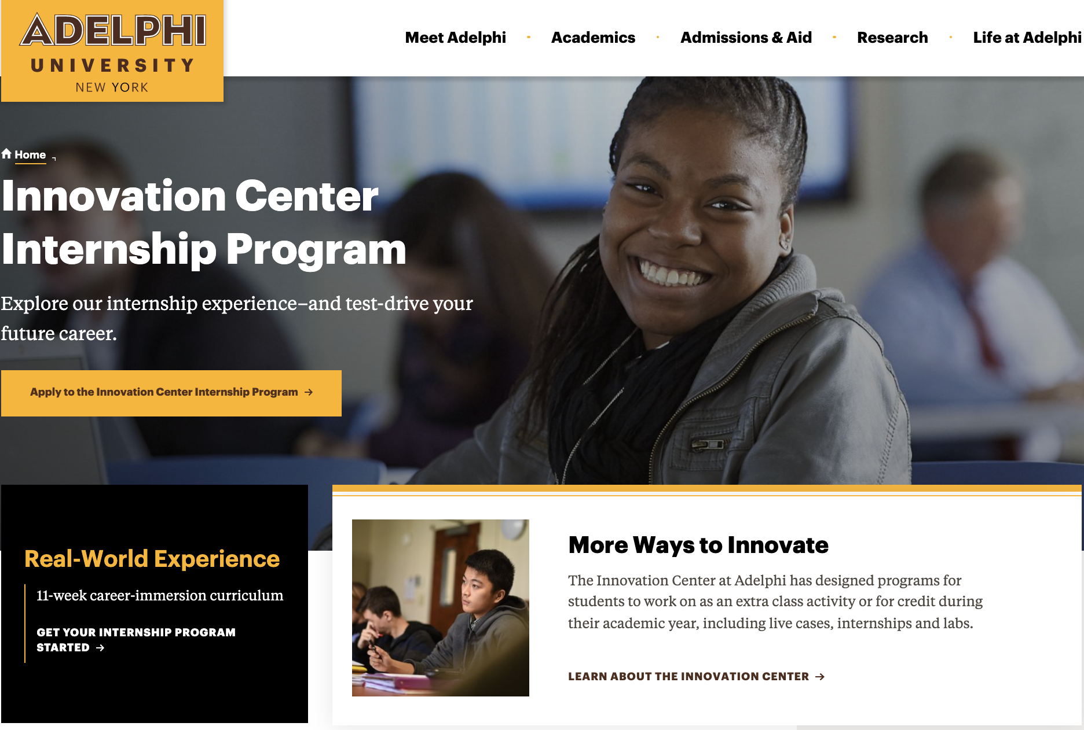
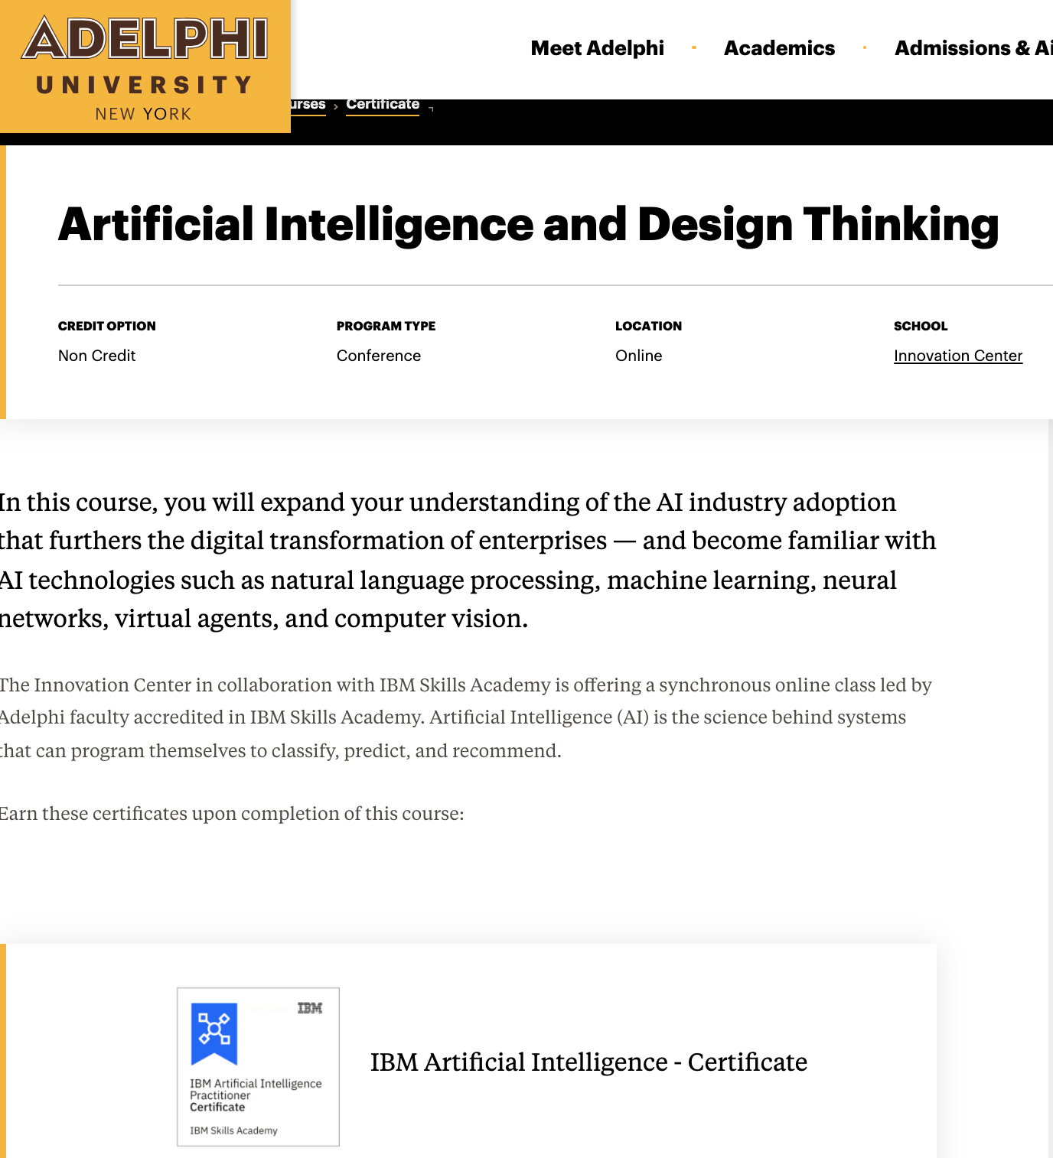
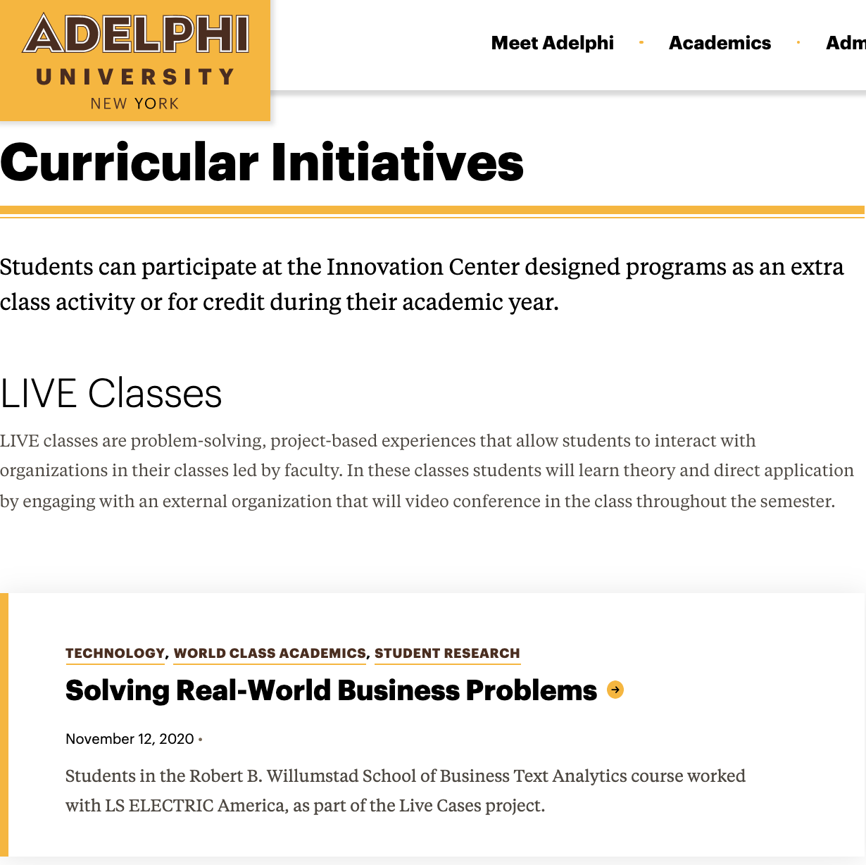
iVA Corpus Content
Notes:
Hazel
We used a web scraper - Beautiful Soup - to gather content from the 10 links we found to the Innovation Center on the Adelphi website.

Slide 13
Libraries We Used
Web Scraper
Text Preprocessing
Model
Interface
Beautiful
Soup
NLTK
and
Speller
Transformer
DASH
Notes:
Chensheng

Slide 14
Beta: Pros and Cons
What Worked:
Some Challenges:
Corrects typos
Gather data from website
Ready-to-go interface
Insufficient amount of data
Imbalance in dataset
Simulate question and answers
Notes:
Chensheng

Slide 15
Beta Methodology
Check words
Pre-trained Q&A Model
Words from users
Into
Preprocess
Get
Match Response
Into
If no match responses
Corpus
Into
Pre-trained model
Get
Answer
Notes:
Chensheng

Slide 16
Beta Chatbot
http://127.0.0.1:8050/
Notes:
Chensheng

Slide 17

Beta II: Proposed Improvements
Deploy Chatbot to multiple platforms
Speed up model processing time
Improve interface design
Stronger branding
Notes:
Team:1-2 Chensheng/ 3 Xuan/ 4 Hazel
--We have not addressed the IC Labs or the Business Plan Competition: https://www.adelphi.edu/news/students-gain-professional-experience-and-boost-their-resumes-at-adelphis-innovation-center/ -- “One of the missions of the Innovation Center,” Fusaro said, “is to provide deep, valuable, experiential learning opportunities to work on a problem with a company or nonprofit organization and have students and faculty find a solution together.”

Slide 18


